Slide 1

UNI LOST
School of Computer Science and Engineering
Department of Computer Science and Engineering
Submitted By: Yashvi Taunk
23FE10CSE00634
Supervised By:
Ms. Harshika Mathur

Slide 2
Outline
Introduction
Literature Review
Problem Statement
Objectives
PROPOSED METHODOLOGY
RESULT
OUTCOME
REFERENCES

Slide 3
Introduction
Frequent Item Loss
Manual & Unorganized Processes
Consequences of Delay
College students frequently lose important items such as ID cards, wallets, essential books, and expensive gadgets, leading to immediate stress and disruption.
Current manual solutions (e.g., paper registers, bulletin boards, informal chat groups) are inherently slow, unorganized, and prone to misplacement of reports.
Delayed recovery results in significant inconvenience, potential loss of important documents, academic setbacks, and widespread user frustration across the campus community.

Slide 4



Introducing the Digital Lost & Found System​
We propose a centralized, web-based platform designed to drastically minimize the time and effort required to locate lost belongings and ensure trust in the recovery process.
Web-Based Platform
Image Upload & Match
Verification & Security
Accessible via any browser, simplifying reporting and searching for all students and administrators.
Users can upload images for visual identification and view automated suggestions for potential matches instantly.​
Admin verification ensures the authenticity of all claims, ensuring items are returned to their rightful owners.​

Slide 5
Literature Review
A comparative analysis of existing methods highlights the clear need for a digitally centralized and automated solution for the campus environment.
Platform
Approach
Limitation
Manual Registers
Paper-based entry
Time-consuming, non-searchable, and easily lost or damaged.
WhatsApp Groups
Informal, chat-based reporting
Lack of formal tracking, verification, and data retention.
Google Forms
Basic form input for data collection
No automated matching algorithm or administrative control over claims.
Observation: Current systems are either inefficient, lack centralized tracking, or require excessive manual effort to manage
claims.

Slide 6
The Gaps in Current Lost & Found Processes
No Automated Matching
Lost item reports are not automatically compared against found item reports, relying instead on manual scanning.
Lack of Image Verification
Identification relies solely on subjective textual descriptions, leading to potential disputes or false claims.
Decentralized Records
Information is scattered across various departments and platforms, making comprehensive searching impossible.
Missing Administrative Control
Absence of a formal process for ownership verification and claim approval.

Slide 7
Problem Statement
"Students face difficulty locating lost belongings due to the absence of a verified and centralized digital Lost & Found system within the campus."
The core problem lies in the inefficiency of current systems, where manual or unstructured methods lead to lost records, opportunities for false claims, and substantial user inconvenience. We need a structured platform that guarantees authenticity and efficiency for all stakeholders.

Slide 8

Objectives
User-Friendly Web Portal
Develop an intuitive portal for seamless reporting and management of lost and found items by students and
faculty.
Scalable NoSQL (MongoDB) Database
Store all item and user data securely in a robust MongoDB Atlas cloud database, ensuring flexible data retrieval,
high availability, and long-term record keeping.
Automated Matching Logic
Implement logic to automate search and matching based on keywords, category, and time, reducing manual effort
and errors.
Authenticity Verification
Establish an admin verification process to thoroughly vet all claims and ensure items are only returned to the
rightful owners.
Detailed Reporting & Statistics
Provide administrators with detailed reports to track trends in lost/found items and measure system effectiveness.

Slide 9
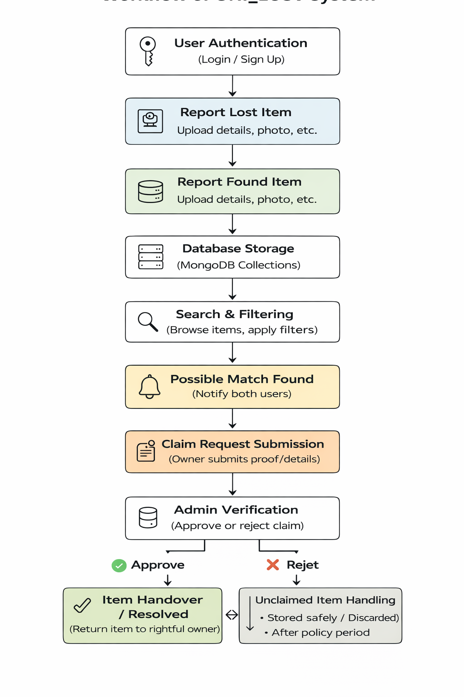
Proposed Methodology

Slide 10
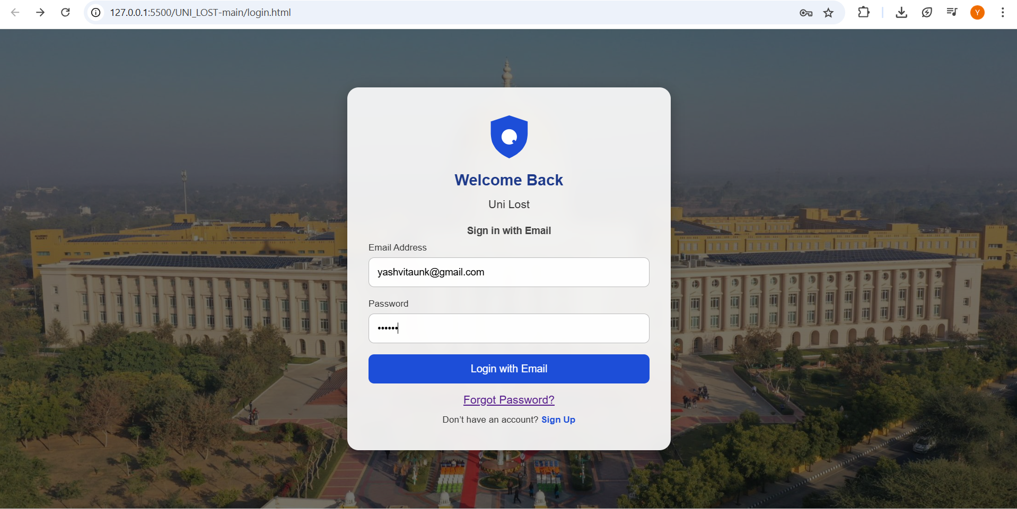
Result
Website Frontend (UI/UX)
Seamless User Experience: Developed a responsive and intuitive interface for easy navigation and item reporting.
Real-time Interaction: Users can register, log in, and post lost or found items instantly.
Dynamic Search & Filter: Integrated functionality to filter items by category and location for faster recovery.
1..SIGNUP/ LOGIN PAGE
(USER AUTEHNTICATION)

Slide 11
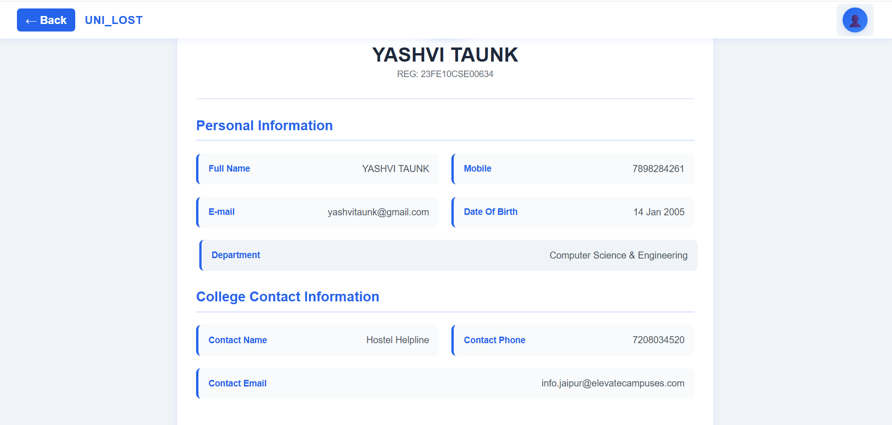
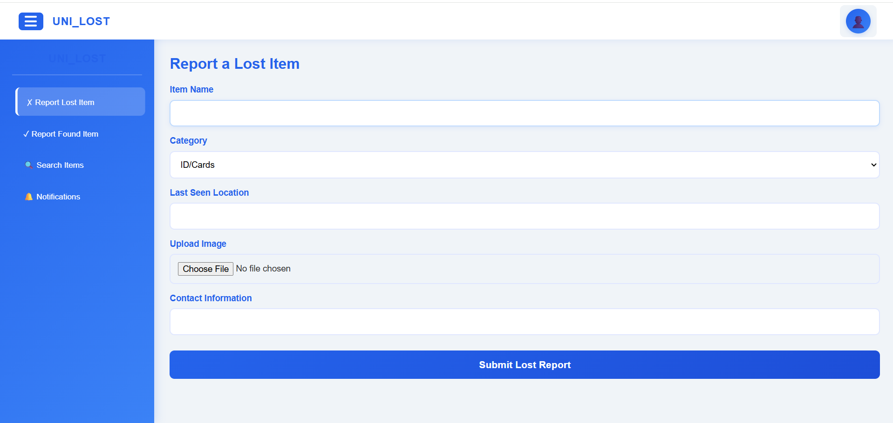
22
3.REPORT LOST ITEMS
​​
​
2.PROFILE SECTION
(USER DETAILS)
​

Slide 12
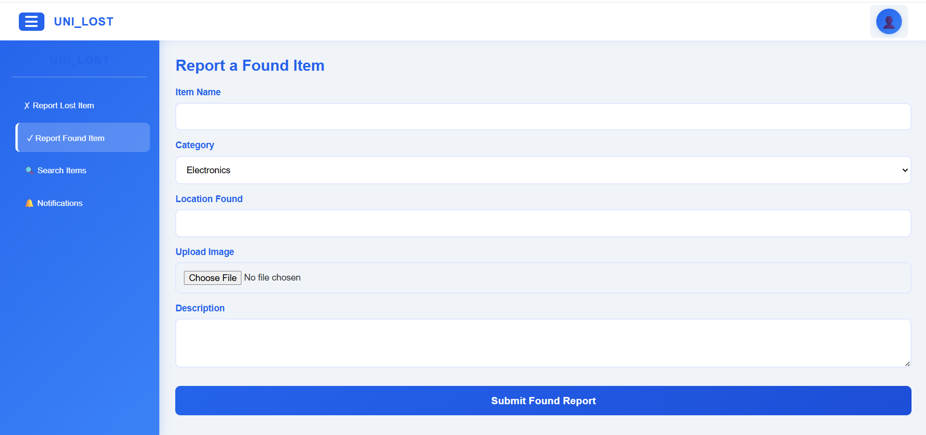
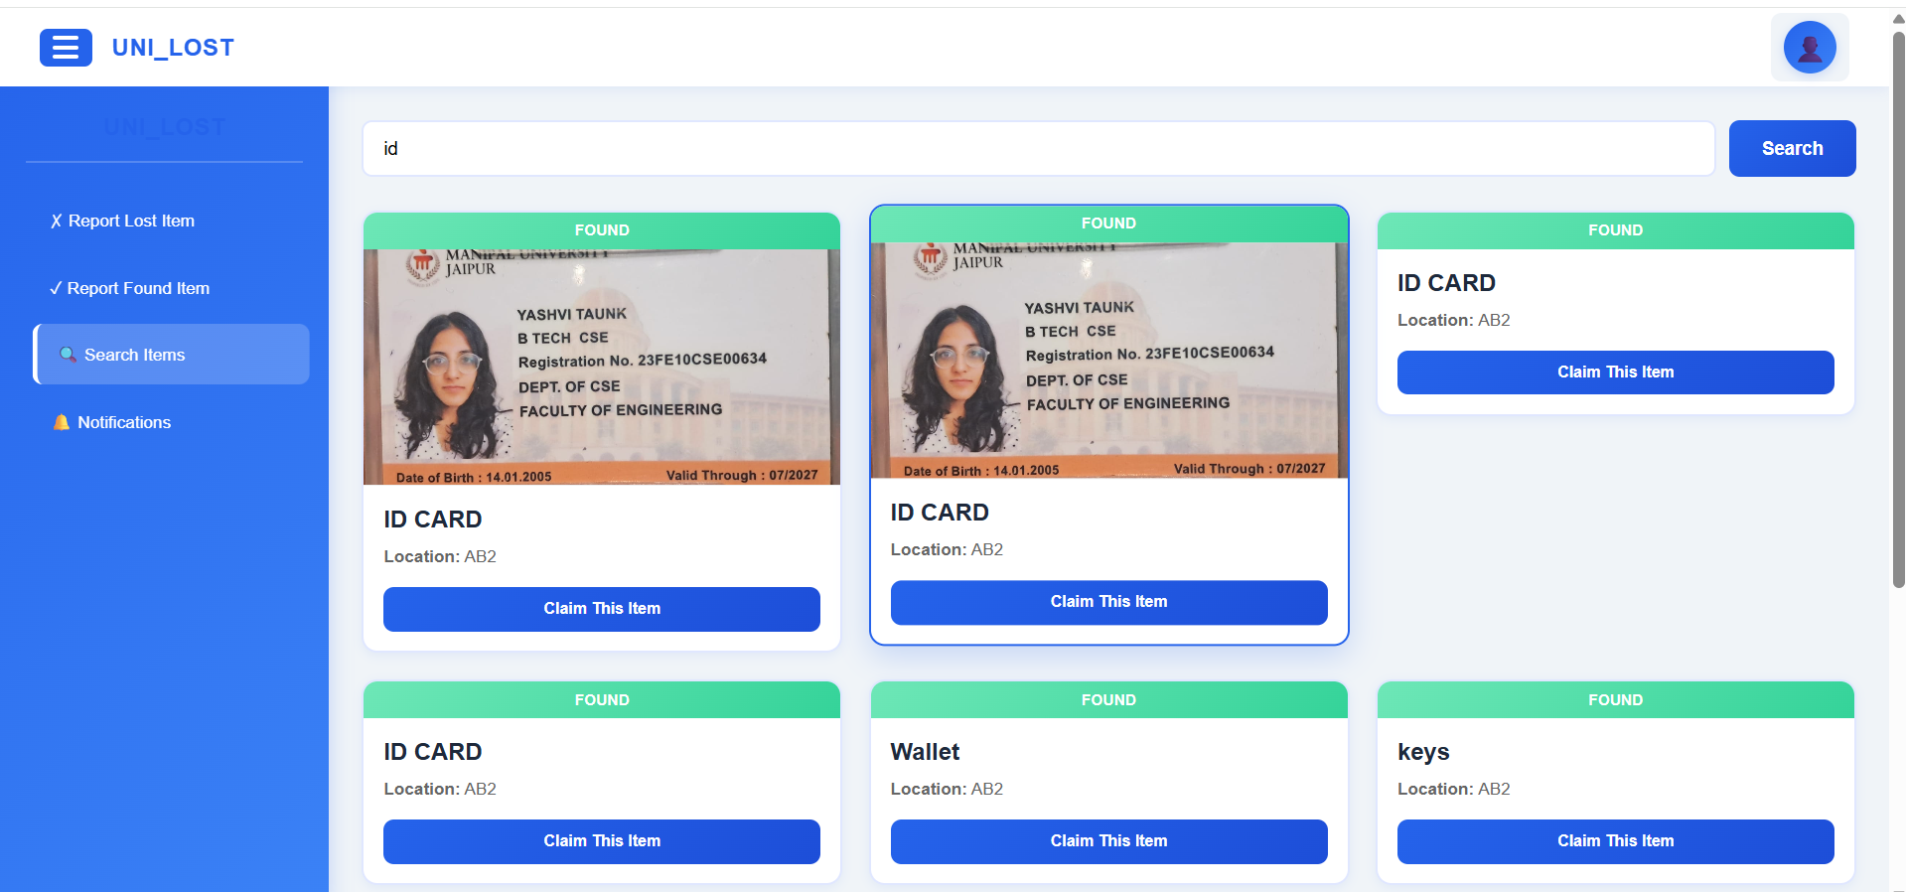
5. SEARCH ITEMS
4.REPORT LOST ITEMS

Slide 13
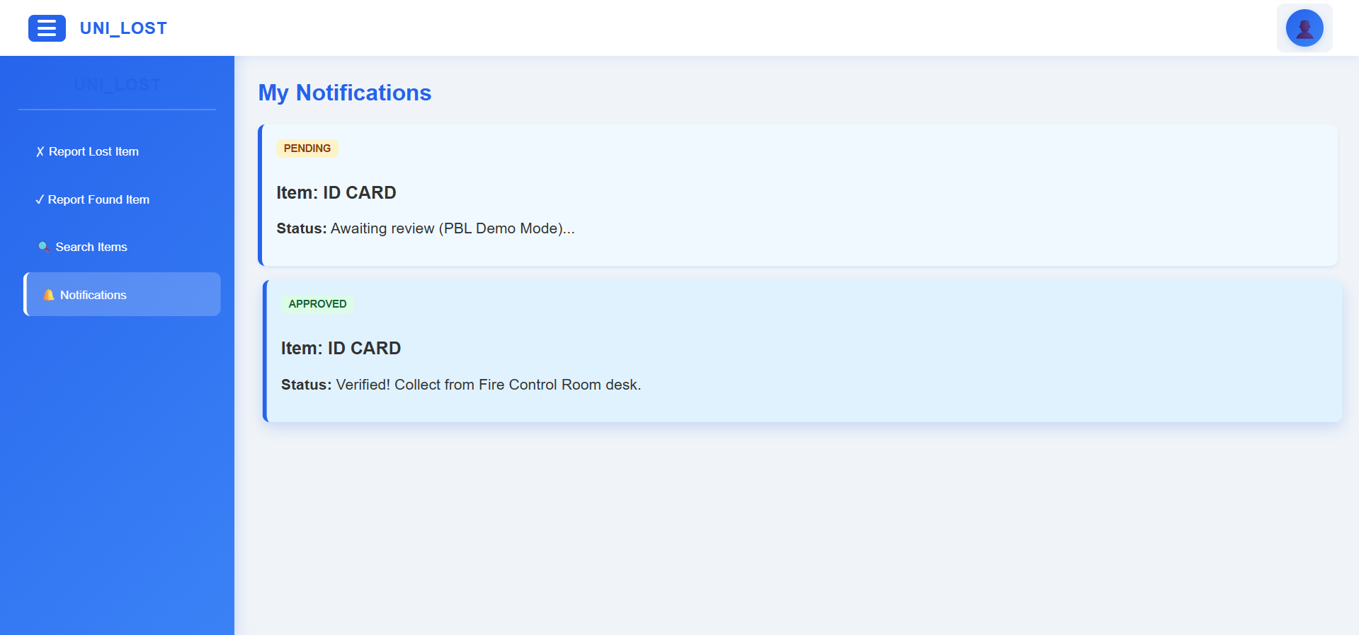
6. NOTIFICATION
Backend & Database (Security & Storage)​​
Cloud Database Integration: Uses MongoDB Atlas for secure, scalable cloud storage of users, items, and reports.
Secure Authentication: Passwords are encrypted using bcryptjs hashing to ensure user data protection.
RESTful API Architecture: Efficient API communication between frontend and backend for smooth data handling.
Deployment on Render: Backend services are deployed on Render for reliable hosting, continuous deployment, and real-time accessibility.
​

Slide 14
Outcome
Successful Digitalization : Successfully replaced inefficient, paper-based processes with a modern, fast, and user-friendly web application.
Enhanced Student Experience: Reduced the stress and time required for students to report or search for lost property, improving overall campus morale.
Seamless Information Flow: Implemented a single-page Dashboard interface ensuring rapid navigation between key actions: Searching, Reporting Lost, and Reporting Found items.
Integrated Security: Incorporated robust client-side validation for login and detailed personal profile integration (Reg. No., Contact, Course) via a Modal Pop-up to streamline verification during the claim process.
Future-Ready Platform: The modular design (using HTML, CSS, and JS) allows for easy integration with future database/backend systems for scaling and permanent data storage.

Slide 15
References
[1] S. Kumar et al., “Web-Based Lost and Found System,” MIT International Journal of Computer Science and Information Technology, vol. 11, no. 1, Dec. 2022.
[2] S. Y. Tan and C. R. Chong, “An Effective Lost and Found System in University Campus,” Journal of Information System and Technology Management, 2023.
[3] “Digital Lost and Found Item Portal,” International Research Journal of Engineering and Technology (IRJET), vol. 10, no. 11, 2023.
[4] “Lost and Found System for VNR VJIET,” International Journal of Engineering Research & Technology (IJERT), vol. 11, no. 6, 2022.

Slide 16
Thank You

